Slide 1
Cloud Friday
Alfredo Dos Santos
Senior Cloud Solution Architect
MEA HQ - OCP

Slide 2

My Cloud Journey as a Client
Traditional Data Center Background
First Cloud Migrations 2008
First production Migration 2009 – SAP
Where I come from?
⬇
Where To Start???
References???
Outcomes???
My Experience with cloud
⬇
Need a plan
Understand the business requirement
Change is needed
Learnings
⬇
2

Slide 3

My Experience supporting Partners
Scenarios
Challenges
Learnings
Getting into Cloud from a traditional background
Meet changing customer demands and deliver a superior experience
Change in Mindset
Remove from product focus
Education around the business
Realize the opportunity of cloud while reducing costs and complexity
Governance and Security
Agility
Methodologies and Frameworks
Born in the Cloud
⬇
⬇
Business Solutions
End user and customer experience
Governance and security included
Accelerate innovation and growth
Improving customer experience
Deeper insight, personalized service, better experiences
3

Slide 4
Microsoft View of Security
4

Slide 5
Sobering Statistics
>63% of all network intrusions are due to compromised user credentials
$7.91 Million Cost of the average data breach to a U.S. company
196 Days Average time it takes to identify a data breach
$600 Billion Estimated cost of cybercrime to the global community

Slide 6
Phishing is phenomenally successful
We must assume that the adversary will penetrate the perimeter
4%
of users will open an obvious phishing e-mail message
96%
Email is still the most common vector
Phishing represents 98% of social
incidents and 93% of breaches
82
seconds is the median time-to-first-click for phishing campaigns

Slide 7
Attack services are inexpensive
Ransomware:
$66 upfront
Or
30% of the profit (affiliate model)
0days price range varies from $5,000 to $350,000
ATTACKS AGAINST THE PC
ATTACKS AGAINST THE EMPLOYEES AND CUSTOMERS
Loads (compromised device) average price ranges
PC - $0.13 to $0.89
Mobile - from $0.82 to $2.78
Spearphishing services range from $100 to $1,000 per successful account take over
Denial of Service (DOS) average prices
day: $102.05
week: $327.00
month: $766.67
Compromised accounts As low as $150 for 400M. Averages $0.97 per 1k.
SERVICES AIDING THE “CASH OUT”
Proxy services to evade IP geolocation prices vary
As low as $100 per week for 100,000 proxies.
ATTACKER
INFRASTRUCTURE
COLLECTIVE KNOWLEDGE

Slide 8
Better Security in the Cloud Than on most on-premises environments
TRADITIONAL APPROACH
CLOUD-ENABLED SECURITY
Unique Business Value
Commodity Resources
Security is a challenging and under-resourced function
Cloud Technology enables security to:
Satisfied responsibility
Partially met responsibility
Unmet responsibility
Shift commodity responsibilities to provider and re-allocate your resources
Leverage cloud-based security capabilities for more effectiveness
Use Cloud intelligence improve detection/response/time
Cloud Provider responsibility (Trust but verify)

Slide 9
Monitoring in depth
ADVERSARY SPACE
NEUTRAL SPACE
Red team
Collaboration
Data Analytics
Single sign on
DATA PROTECTION
Only one line of defense (Global Security Services)
= Adversary
Location/device based ACL
Data loss prevention
Compliance
Web gateway
NETWORK SECURITY
Cloud visibility
Web application firewall
Advanced persistent threat/zero day
Email encryption
Email gateway
Network intrusion detection
Watermarking
Password vault/ management clients
SERVER SECURITY
Mobile Device management
Metasploit
Virtual private network
Managed network intrusion detection
Smart tokens
Investigative logging
Forensics
Anti-phishing/ .exe controls
Endpoint security
Public Key Infrastructure (PKI)
On-premises web gateway
Firewalls
Database encryption
Security compliance
Endpoint protection
Penetration testing
Anti-virus
Web Malware protection system
Application whitelisting
Privileged management
Configuration hardening
Endpoint security
Mail malware protection system (on-premises)
CLIENT SECURITY

Slide 10
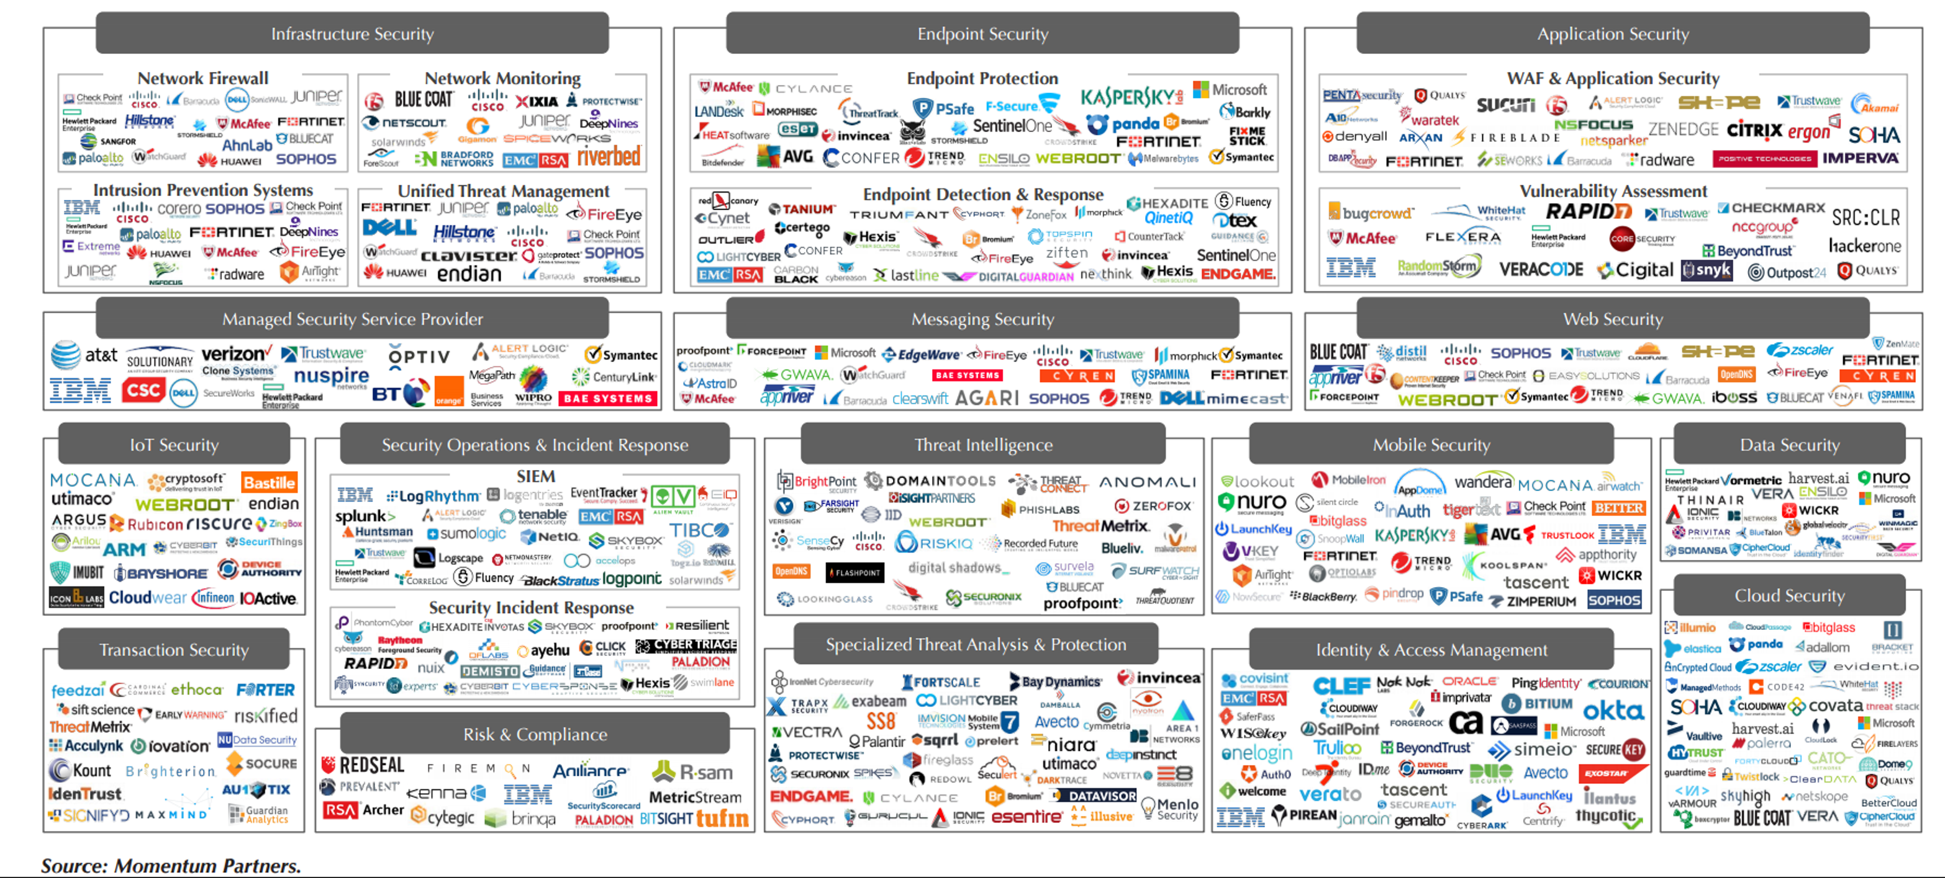
“Best of breed?” or “Best integrated solution?”
Microsoft wants to evolve your perspective to…
Best for my organization platform

Slide 11






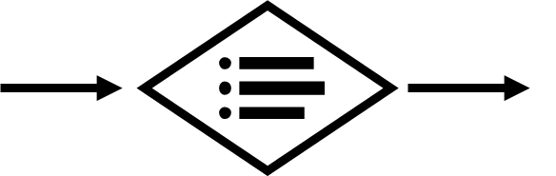

















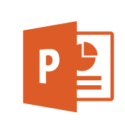
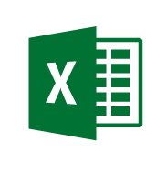





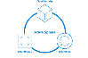


Security Operations Center (SOC)
Software as a Service
Vulnerability Management
Cybersecurity Operations Service (COS)
Cybersecurity Architecture
Office 365
Incident Response and Recovery Services
Secure Score
MSSP
Azure
Security Center
Windows Defender
Office 365
Security & Compliance
Azure
Customer Lockbox
SIEM + Analytics
Cloud App
Security
Advanced Threat Protection (ATP)
Dynamics 365
Identity & Access
Graph Security API (Public Preview)
Information Protection
Azure Active Directory
Alert & Log Integration
Conditional Access – Identity Perimeter Management
Clients
Hybrid Cloud Infrastructure
Cloud App Security
Azure AD Identity Protection
Leaked cred protection
Behavioral Analytics
Unmanaged &
Mobile Devices
On Premises Datacenter(s)
3rd party IaaS
Microsoft Azure
Azure Information Protection (AIP)
Discover
Classify
Protect
Monitor
Azure Security Center – Cross Platform Visibility, Protection, and Threat Detection
Configuration Hygiene
Just in Time VM Access
Azure AD PIM
NGFW
Security Appliances
Adaptive App Control
Multi-Factor Authentication
Intune MDM/MAM
Classification Labels
Managed Clients
Extranet
Edge DLP
Azure Policy
Hold Your Own Key (HYOK)
Azure AD B2B
SSL Proxy
Azure Key Vault
AIP Scanner
Azure AD B2C
IPS
Hello for Business
Express Route
Azure WAF
System Center Configuration Manager
Windows Server 2016 Security
Window 10 + Just Enough Admin, Hyper-V Containers, Nano server, and more…
Azure Antimalware
Office 365
Data Loss Protection
Data Governance
eDiscovery
MIM PAM
Windows Defender ATP
Application & Network Security Groups
Azure ATP
Shielded VMs
VMs
Intranet Servers
Backup & Site Recovery
Azure Stack
Azure SQL
Threat Detection
Active Directory
Secure Score
Threat Analytics
Privileged Access Workstations (PAWs)
Disk & Storage Encryption
SQL Encryption & Data Masking
ESAE Admin Forest
Windows 10 Enterprise Security
IoT and Operational Technology
Included with Azure (VMs/etc.)
Premium Security Feature
Confidential Computing
Azure SQL Info Protection (Preview)
Network protection
Credential protection
Exploit protection
Reputation analysis
Full Disk Encryption
Attack surface reduction
App control
Isolation
Antivirus
Behavior monitoring
DDoS attack Mitigation+Monitor
Windows 10 IoT
Azure Sphere
IoT Security Maturity Model
Endpoint DLP
Azure IoT Security
IoT Security Architecture
Compliance Manager
S Mode
Security Development Lifecycle (SDL)
Trust Center
Intelligent Security Graph

Slide 12
Planning a Journey to the Cloud
12

Slide 13
76% of CEOs consider DT their #1 priority
Trends that will transform business over the next five years
76%
69%
58%
39%
28%
Technological advances
Demographic shifts
Shift in global economic power
Resource scarcity & climate change
Urbanization
Source: PWC CEO Survey

Slide 14
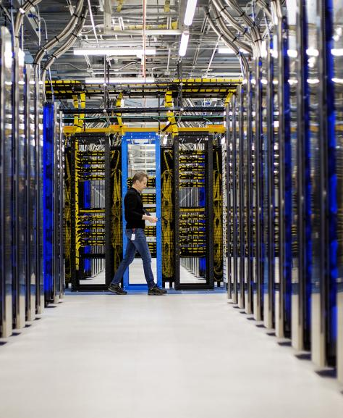
Modern business in the cloud is the new normal
Today’s world reflects a new reality:
Technology is ever-present through the cloud, offering easy access to digital services…
Capitalizing on this shift is key for the organization’s innovation and growth

Slide 15
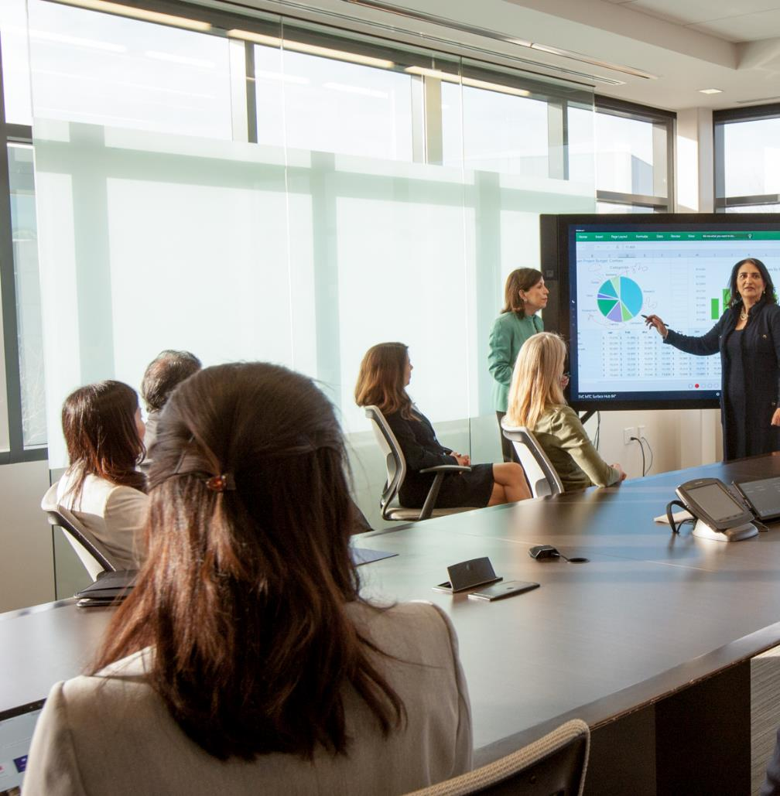





Key Business Drivers
Modernization
Business Transformation enabled by Cloud Technologies
Improving customer and employee experiences
Transformation
Evolving how businesses operate and interact with the market
Growth
Scaling products and services to meet ever growing business needs
Business Returns
IT must rapidly produce measurable business returns to stay relevant

Slide 16



Microsoft Cloud Adoption Framework for Azure
Business Strategy
Actionable, efficient, and comprehensive Azure cloud guidance from Microsoft to accelerate your adoption journey
Microsoft Cloud Adoption Framework for Azure enables you align business, people and technology strategy to achieve your business goals
Technology Strategy
People Strategy

Slide 17
Microsoft Cloud Adoption Framework for Azure
Best practices
Templates
People
Process
Technology
Documentation
Tools
Achieve balance
Align business, people and technology strategy to achieve business goals with actionable, efficient, and comprehensive guidance to deliver fast results with control and stability.

Slide 18
Thank You

